Slide 1
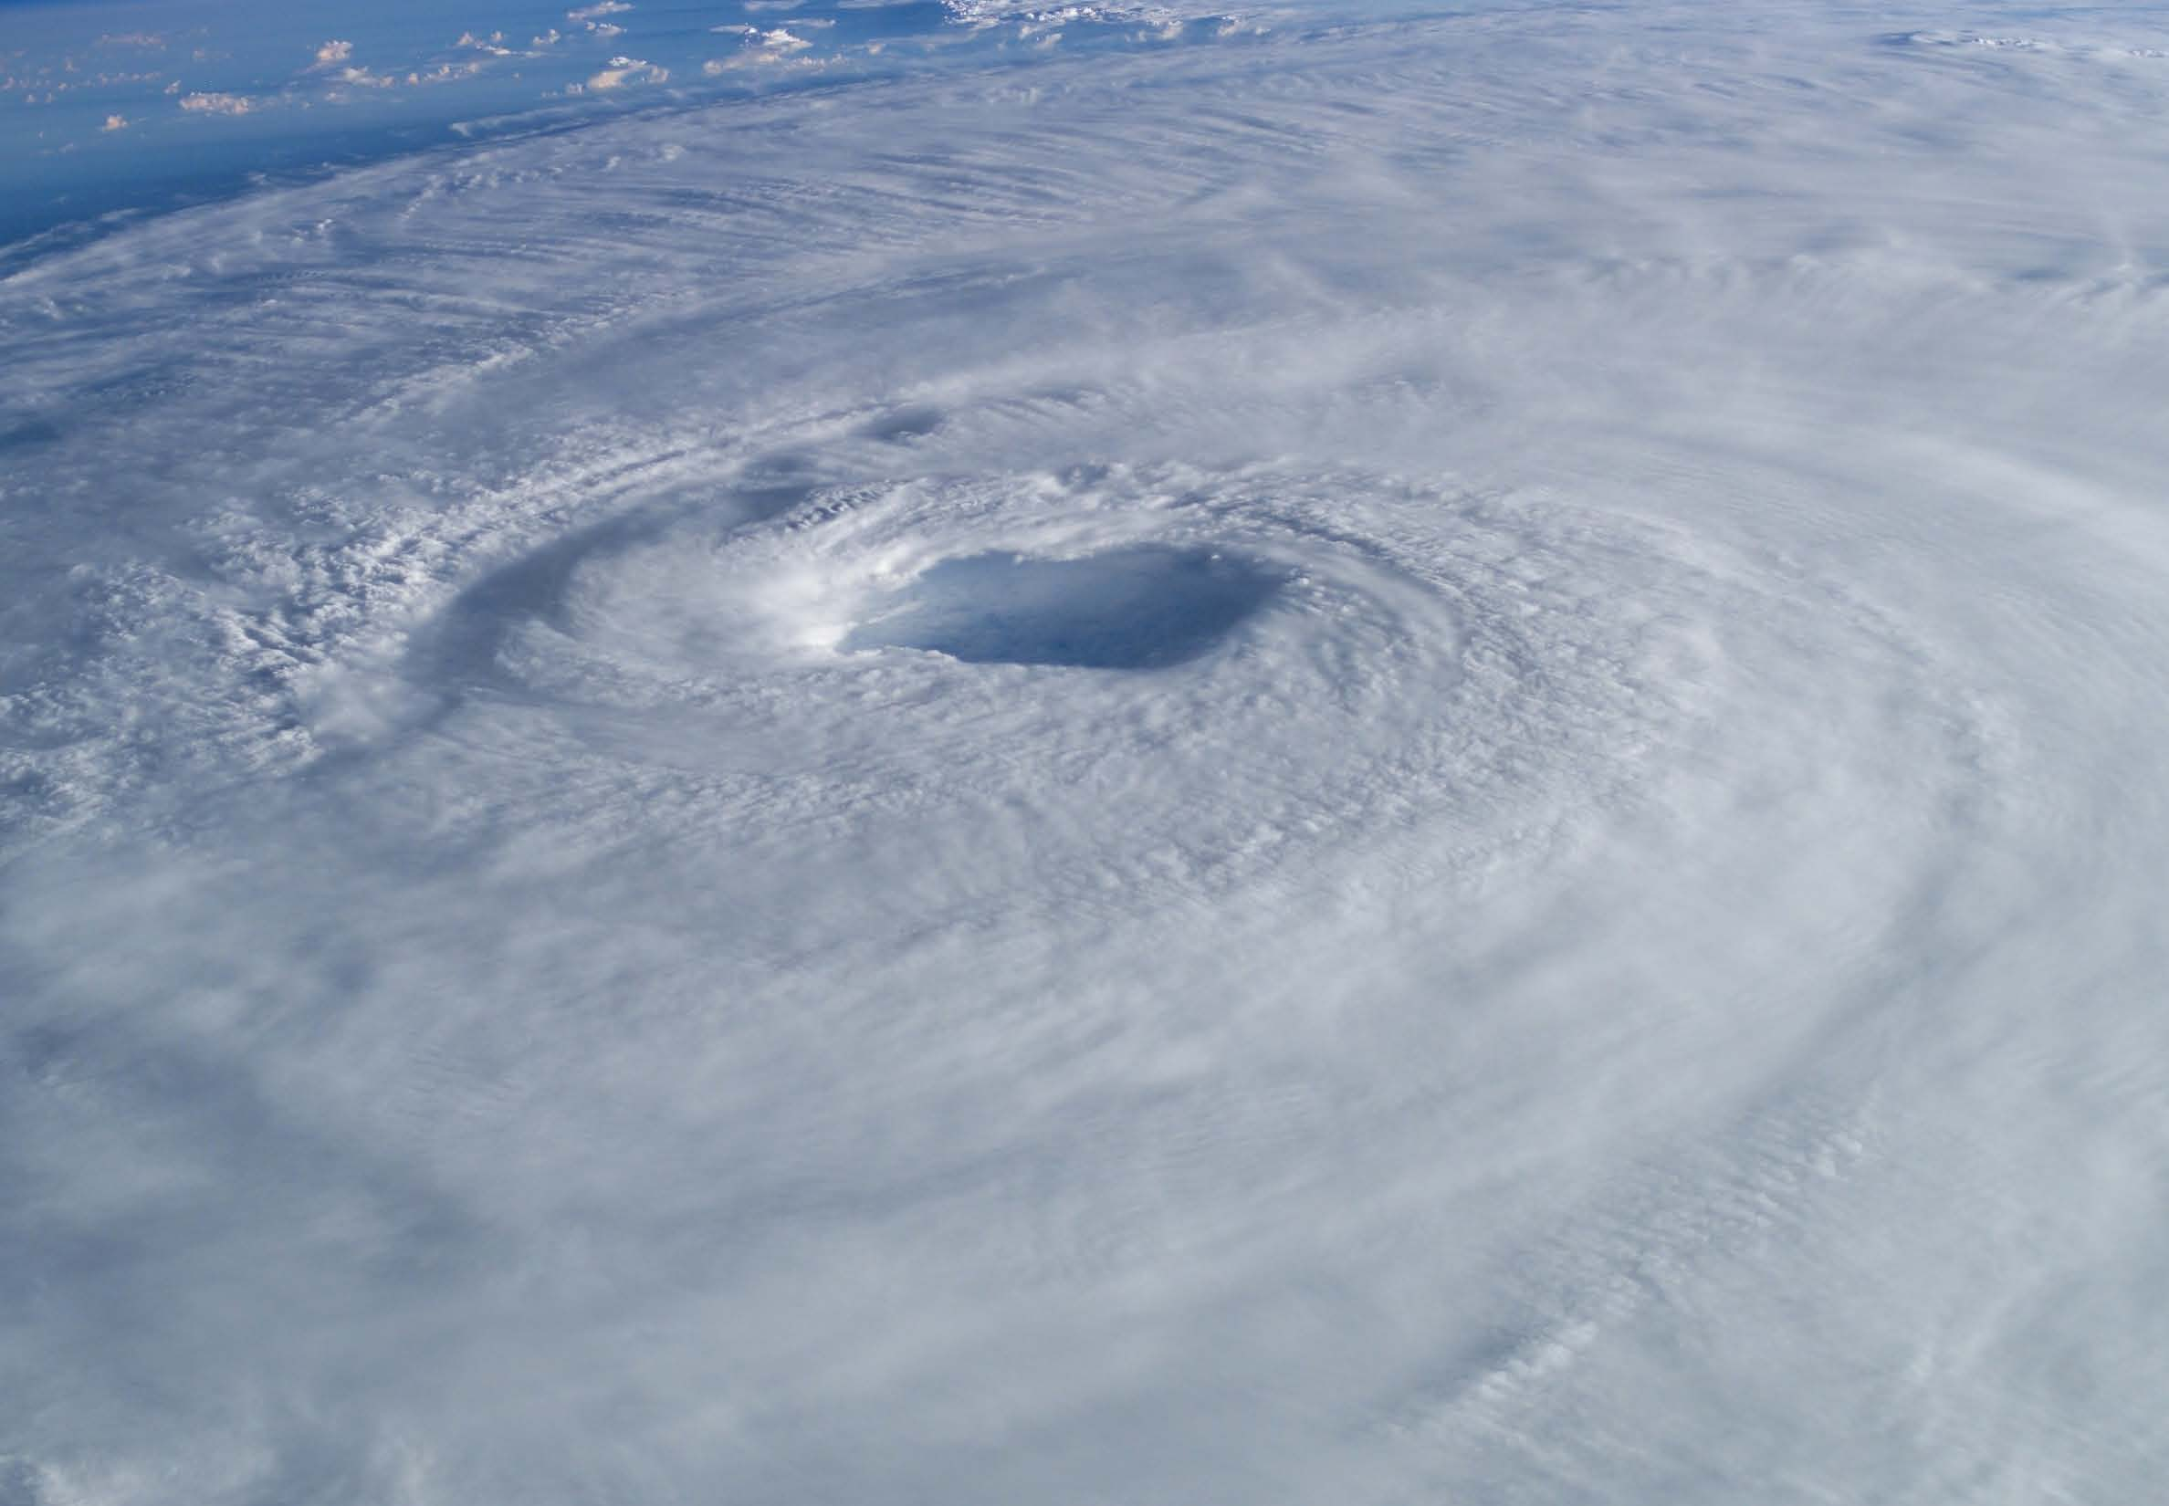

Can cyclone induced cooling offer refuge to thermally stressed corals?
Adam Carrigan and Dr. Marji Puotinen

Slide 2
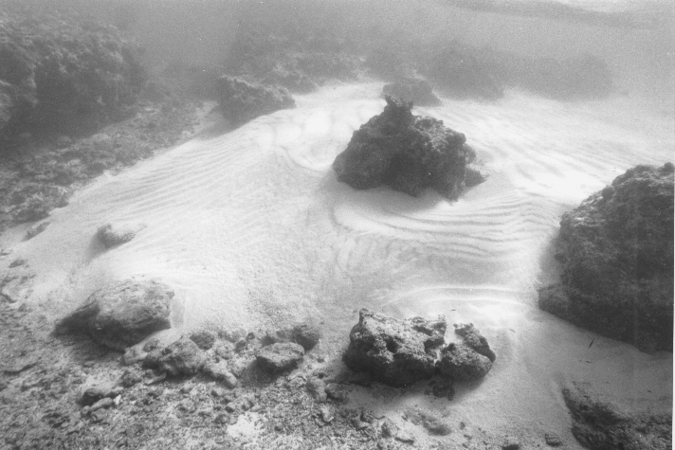
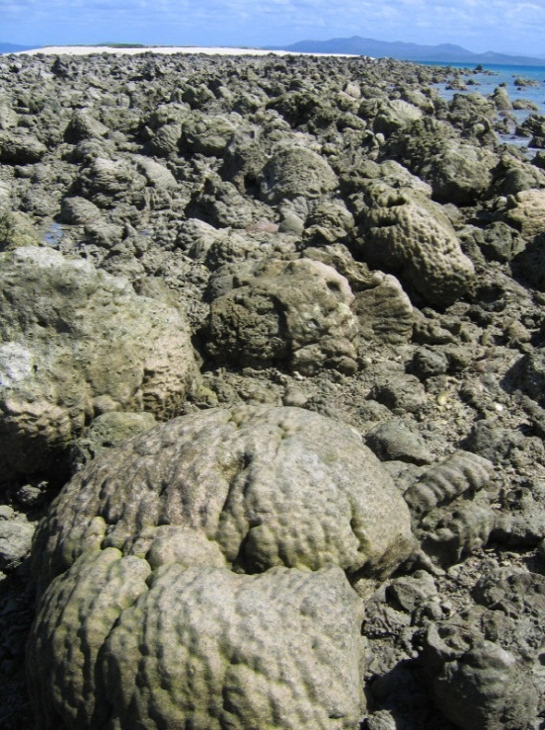
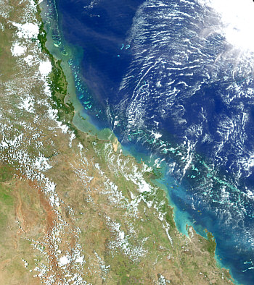
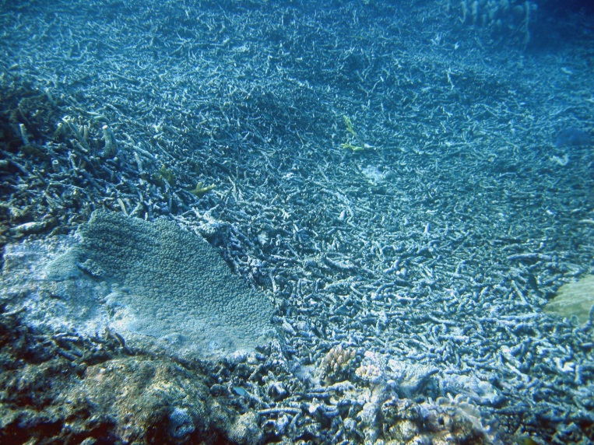
Dislodgement
Sediment
transport
TCs are widely known to damage reefs but…
Flood plumes
Breakage
Notes:
Pictures or disturbance regime

Slide 3
…they can also help reefs
Tropical cyclones reduce upper ocean temperature
Anomalies extend 100s of km beyond TC wave damage zone and can persist for weeks
TC cooling prevented severe bleaching in some areas during 2005 bleaching event (Manzello et al. 2007)
Talk outline
GBR case study of severe TCs – methodology
Caribbean case study of TCs and thermal stress
Global TC cooling near reefs
Notes:
Re: persistence of anomalies – cooling can slow seasonal warming cycles and accelerate seasonal cooling cycles

Slide 4
Mechanisms of Cyclone Cooling
Three main processes: vertical mixing, advection and air-sea heat exchange
Vertical mixing - - dominant mechanism (accounts for ~80% of cooling, but can vary)
Image from Heron et al. 2007
Horizontal Advection - modulates spatial pattern of wake, becomes more dominant away from TC track
Evaporation - dominates air-sea heat exchange (clouds and precipitation play negligible role)
Notes:
How cooling happens in shallow water.

Slide 5
GBR Case Study
1985
2011
Mean translation speed
Intensity and size of all GBR TCs (n=46)
Notes:
Ideal opportunity for case study - TCs are clearly the most intense in the GBR since 1985
Case study TCs vary in size (gale radii): yasi very large, others medium sized, Anthony small

Slide 6
Defining the cooling zone
MAX
2 week post-TC SST – 2 week pre-TC SST (sustained drop)
Spatial extent confined to radius of gale force winds
Data: 28-km Daily OI SST; IBTRACS TC database
Notes:
2-week SST difference – coral specific
Gale radius – conservative

Slide 8
Cooling in shallow waters – GBR example
Notes:
Capricorn channel separates inner/outer reefs. Complex topography with numerous intrusion areas that allow advection into shallow areas.

Slide 9
Comparing two active seasons in the Caribbean
Pre-August
Post-August
Tropical cyclones
Weak Strong
Weak Strong
Coral reef
Timing and distribution of TCs differed. Thermal stress high in both.

Slide 10
TC cooling
Thermal stress
2005
High thermal stress = low TC cooling.
High TC cooling = low thermal stress.
2010
Without TCs, would thermal stress have extended further?

Slide 11
Changes in thermal stress with and without TC cooling…
2005
Mean hotspots
No TC cooling
TC cooling 1⁺ deg
= Short term stress
Mean DHW
2010
No TC cooling
TC cooling 1⁺ deg
= Long term stress
Stress higher at reef pixels with no TC cooling – solid line above dotted line
Notes:
Time evolution of mean hotspot (orange lines) and DHW (red lines) bi-weekly thermal stress data at 56-km cells containing reefs across the Caribbean for the 2005 (A) and 2010 (B) Atlantic hurricane seasons. Pixels with an accumulated TC-induced cooling (based on 2-week sustained drop) of 1°C or greater are depicted by dashed lines while solid lines represent pixels with negligible TC-induced cooling.

Slide 12
Coincidence of thermal stress (DHW ≥ 3) and TC cooling (event ≥ 1ºC) at reefs
Notes:
Many unknowns regarding how warming SST will affect TC activity. High confidence that average intensity and number of intense storms will increase. Also evidence that storms mature faster – low latitude reefs closer to development zones. Little confidence in changes to total number or size of TCs.

Slide 13
Probability of cooling in reef areas
Based on 25-year historical cooling at each 28-km reef cell
Notes:
Based on 25-`year historical cooling at each 28-km reef cell

Slide 15
Figure 4. Poisson probability that a cooling event of at least 0.5°C (A) and 1°C (B) will both occur in a given year at a 28 km reef cell in the Indo-Pacific based on a 25 year history (1985-2009) of tropical cyclone cooling
Notes:
Lot to digest here…obviously North Pacific has highest probability and there’s a clear latitudinal gradient. However also variability by latitude. Note for example the southern GBR which can have occasional mild cooling but no major cooling – possibly to do with the complex topography in the area

Slide 16


Summary
Increased frequency of thermal stress events will likely lead to more interactions in the future – but this will be dependent upon regional TC variability
TC cooling shows potential to provide periodic refuge from warm SST but future work is required to:
Increase spatial resolution (e.g. to 4 km AVHRR SST)
Account for regular processes of SST variability
Further compare cooling with thermal stress metrics
Integrate cooling into TC damage modeling (‘net effect’)
Acknowledgements
Notes:
TC cooling seems worth investigating further – results indicate it shows potential to provide periodic refuge.

